Slide 1


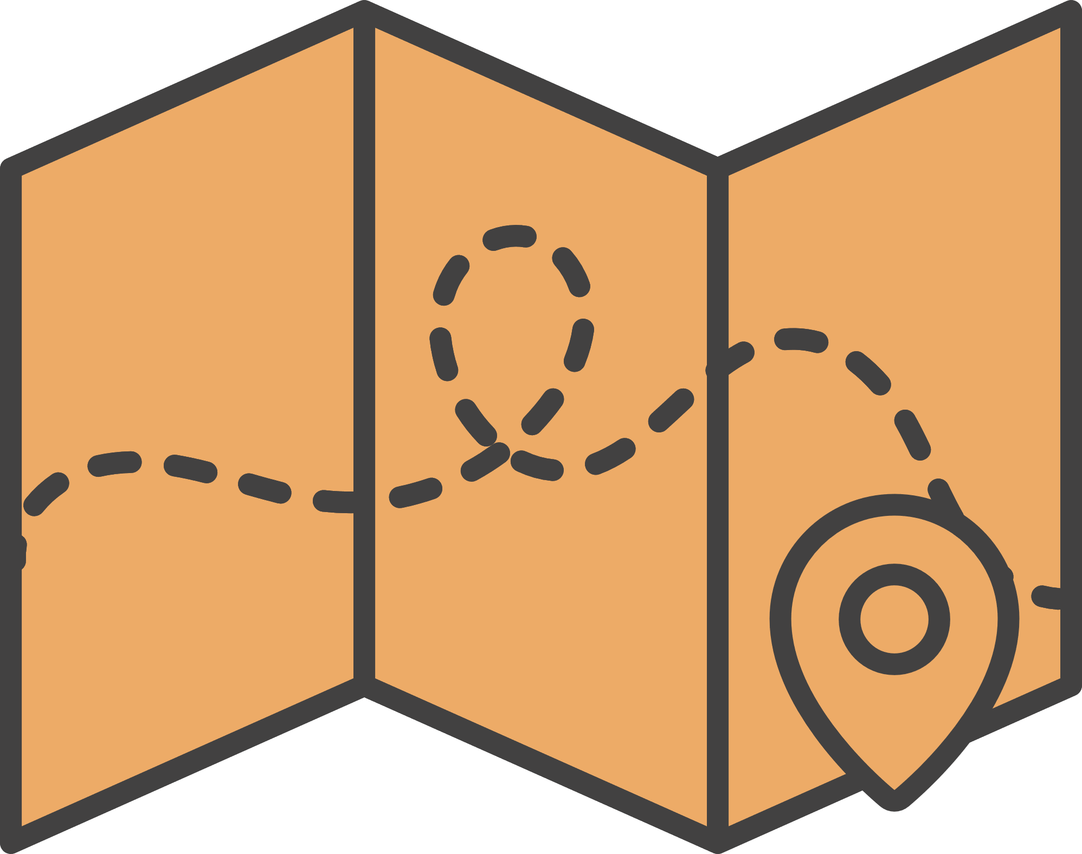
EGY ROUTES
ID | Name
20216083 | Mohamed elyousfy
20216065 | Ali Amr Moussa
20216002 | Ahmed Ashraf
20216086 | Mohamed Shawky
20206058 | Mohamed ibrahim

Slide 2
What is the problem?
Inefficient and unreliable microbus routes leading to wasted time and frustration for commuters.
Lack of awareness about alternative, lesser-known microbus routes that could offer quicker and more convenient travel options.
Difficulty for users, especially tourists or newcomers, in navigating unfamiliar cities using microbuses.

Slide 3



Project Idea
Map app charts microbus routes, user input, efficient pathfinding algorithm.
App improves microbus routes using user input and real-time data.
Users input start and end points, get optimized microbus routes, track progress, and give feedback.
Create reliable, user-friendly microbus navigation tool for commuters and tourists.

Slide 4
Target Audience
Commuters who rely on microbuses for daily transportation within urban areas.
Anyone looking for efficient and cost-effective transportation solutions within specific routes or regions.
Age
16+

Slide 5
Our Key features
User-suggested routes to leverage local knowledge and identify hidden or efficient microbus routes.
Pathfinding algorithm for calculating optimal routes based on user inputs, real-time data, and traffic conditions.
Location tracking for route verification and real-time progress monitoring during travel.
Consensus mechanism and user feedback system to validate route reliability, gather continuous improvement insights, and promote community engagement.

Slide 6
Color schema
Main background color
#ffffff
Header, navbar, buttons
#009EFF
Fonts
#000000

Slide 7
Competitors
Functionality | EGY Routes | Citymapper | Google Maps
Localized for Egyptian market | ✔ |  | ✔
Submit new route suggestions | ✔
Provides real-time pricing information | ✔ | ✔
Participate in route optimization | ✔
Promotes events while offering the most efficient routes | ✔

Slide 8
Functionalities
Submit new route suggestions
Provide real-time pricing information
Participate in route optimization
Promote events while offering the most efficient routes
Manage Account

Slide 9
Functionalities
Search for routes
View history
View suggested route
View vouchers

Slide 10
User Experience
At EGY Routes, we prioritize user engagement and satisfaction.
Our platform operates on the principle of user feedback, where our users actively
contribute to route optimization.
Enhancing User Experience with Collaborative Route Optimization:
User-Driven Route Suggestions
Collective Decision-Making

Slide 11
User Experience
User Benefits:
Empowerment
Customization
Continuous Improvement

Slide 12
Feedback Mechanisms
At EGY Routes, we value our users' input and strive to create a platform that caters to their needs. Central to our design philosophy is the integration of various feedback mechanisms, empowering users to shape their experience.
Rating Systems
Feedback Forms
User Engagement Initiatives

Slide 13
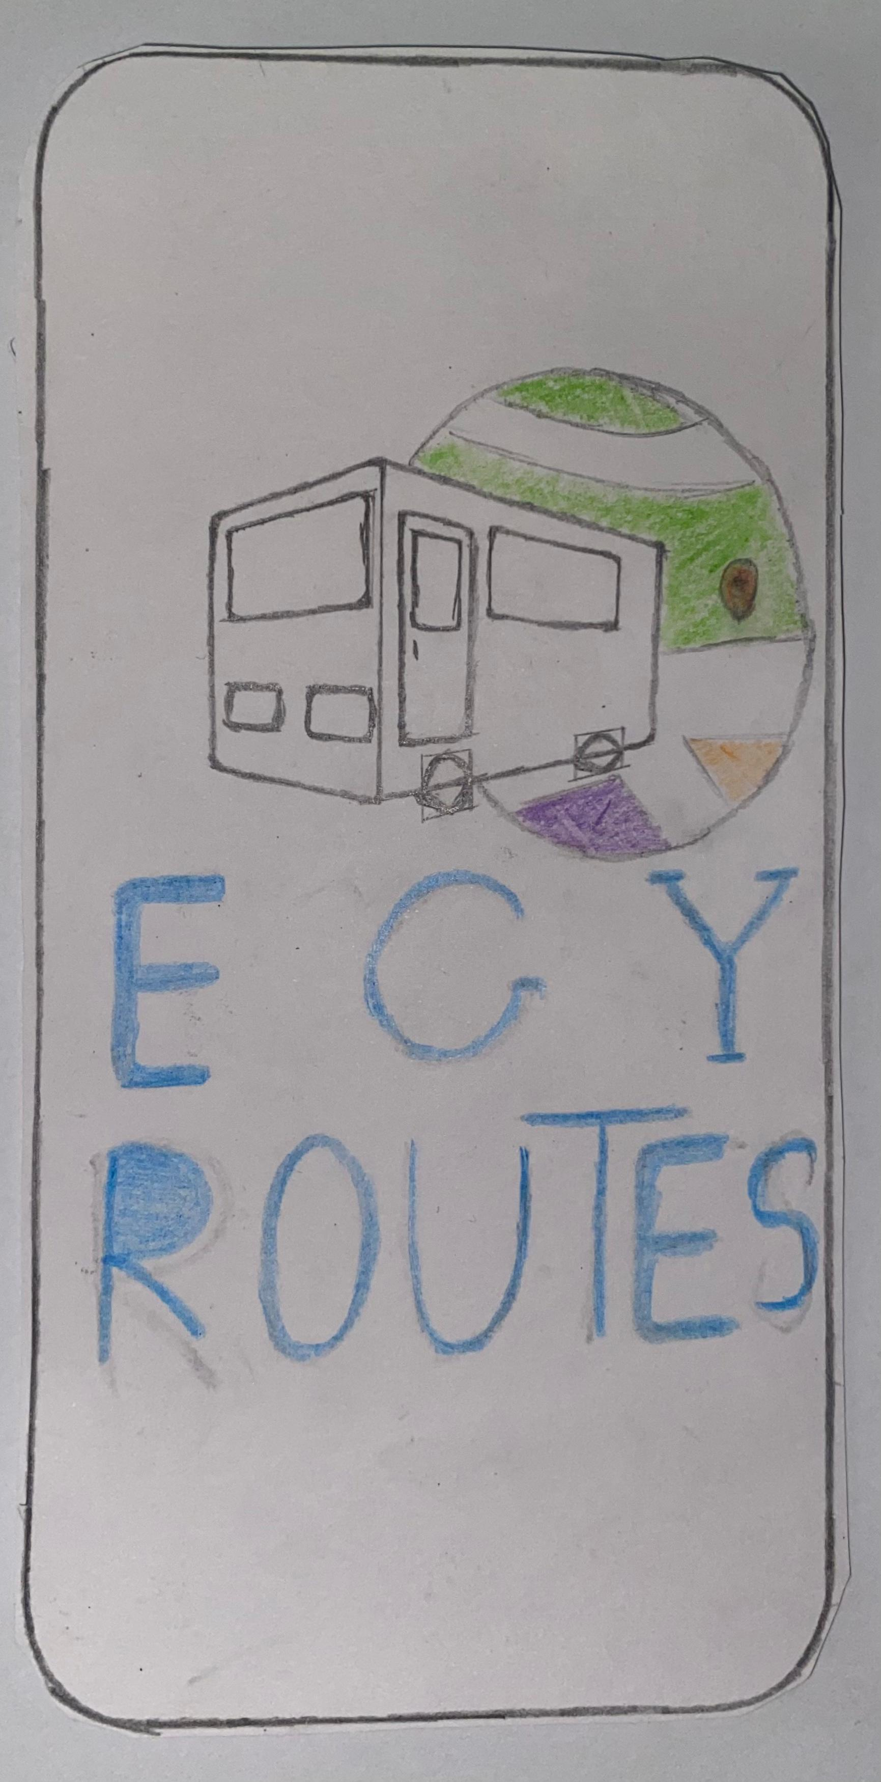
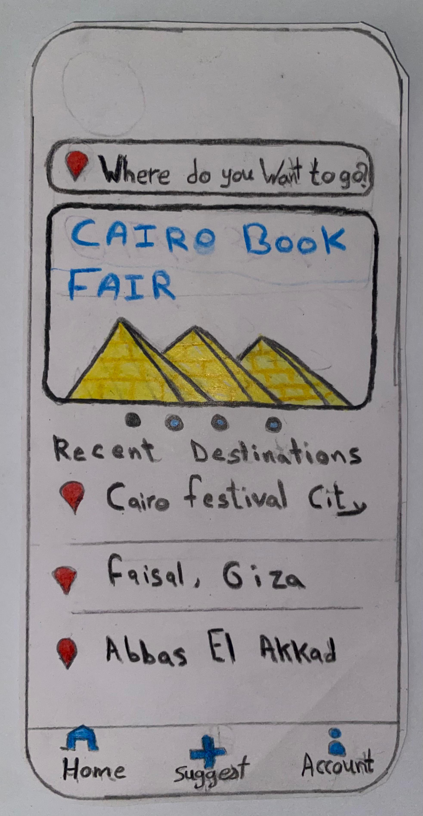
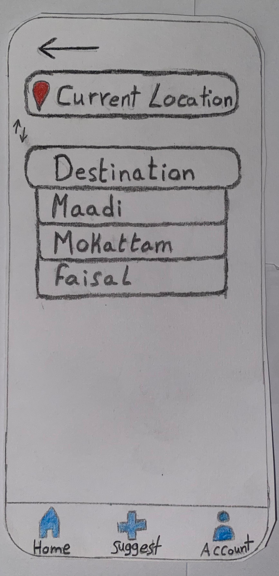
Sketches
Logo
Home
Search

Slide 14
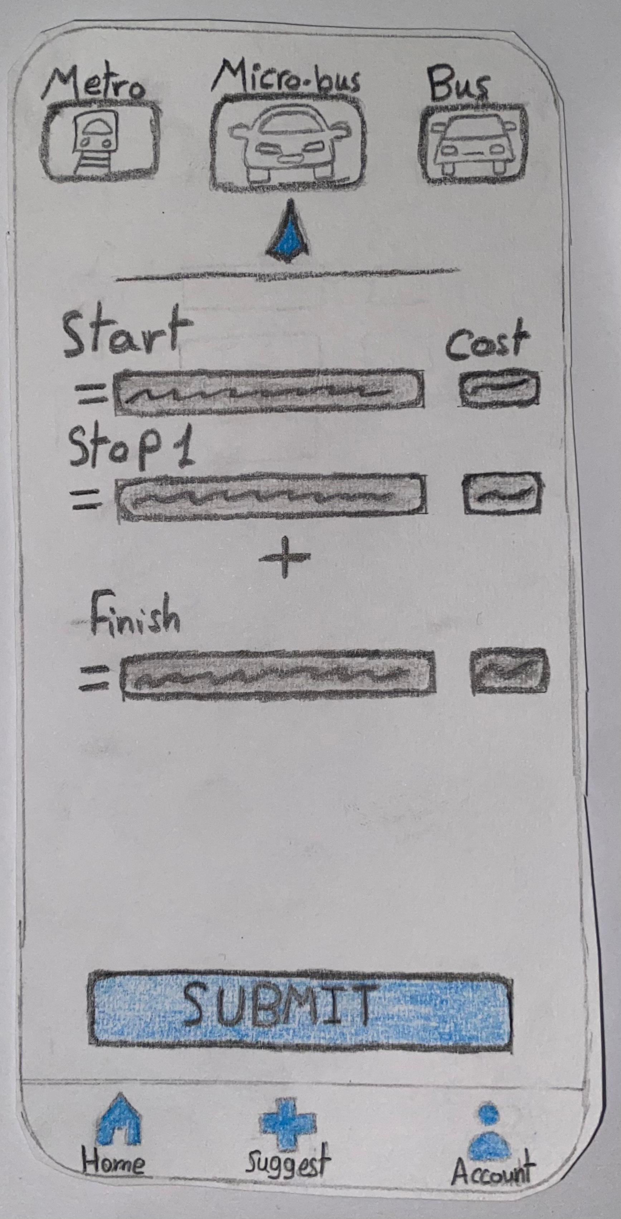
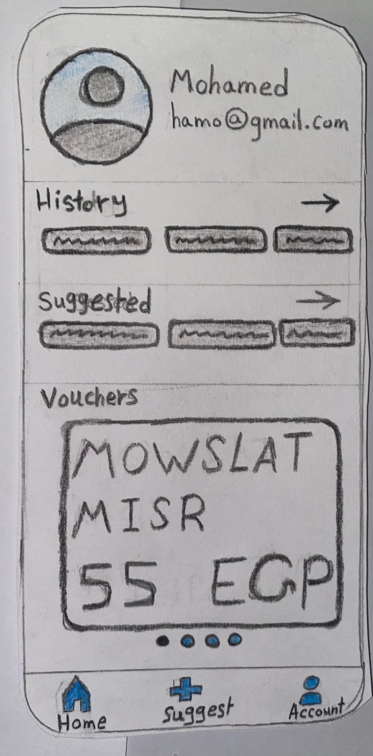
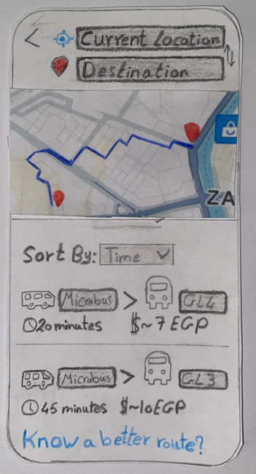
Sketches
Routes view
Suggest
Account

Slide 15
Application Prototype Video
https://drive.google.com/file/d/1LSNBEx-QWNYNaY0JygyYVW_Wy3JDMjP4/view?usp=drive_link

Slide 16
Conclusion!
In conclusion, our map-based microbus route mapping application offers a user-centric solution for efficient and reliable microbus navigation. By leveraging user suggestions, real-time data, and robust pathfinding algorithms, we provide commuters, tourists, and city residents with a valuable tool for optimizing their transportation experiences, saving time, and enhancing overall travel convenience. Our emphasis on design, user experience, feedback mechanisms, and continuous improvement underscores our commitment to delivering a high-quality and impactful mobile application for urban commuters.

Slide 17

Thank You!

